Slide 1
Day 5
Soc investigation process
- Presented by: Aditya jamkhande

Slide 2
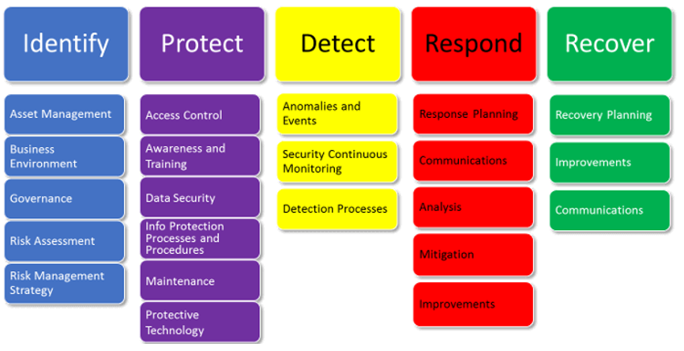
NIST Cyber Security framework

Slide 3
Core responsibilities
A SOC team has two core responsibilities:
Maintaining security monitoring tools – The team must maintain and update tools regularly. Without the correct and most up-to-date tools, they can’t properly secure systems and networks. Team members should maintain the tools used in every part of the security process.
Investigate suspicious activities – The SOC team should investigate suspicious and malicious activity within the networks and systems. Generally, your SIEM or analytics software will issue alerts which the team then analyzes and examines, triages, and discovers the extent of the threat.

Slide 4
Steps followed by analyst
Monitoring
Triage
Basic Investigation
Deep Dive Investigation
Remediation
Closure

Slide 5
Monitoring
Cybersecurity monitoring is the process of continuously observing what is happening in your organization’s ecosystem with the aim of detecting cyber threats and data breaches.
Done in the following way:
Monitor alerts, dashboards and reports
Identify Indicators of compromise or indicators of attack
Perform adhoc investigation

Slide 6
Alerts, dashboard and reports
Alerts
An alert is based on a scheduled saved or real time search that whenever certain conditions are overcome, generates one or more actions to be executed
Dashboards
A dashboard is a visual display of all of your data. While it can be used in all kinds of different ways, its primary intention is to provide information at-a-glance, such as KPIs
Reports
A cybersecurity report presents critical information about cybersecurity threats, risks within a digital ecosystem, gaps in security controls, and the performance of security programs at regular intervals

Slide 7
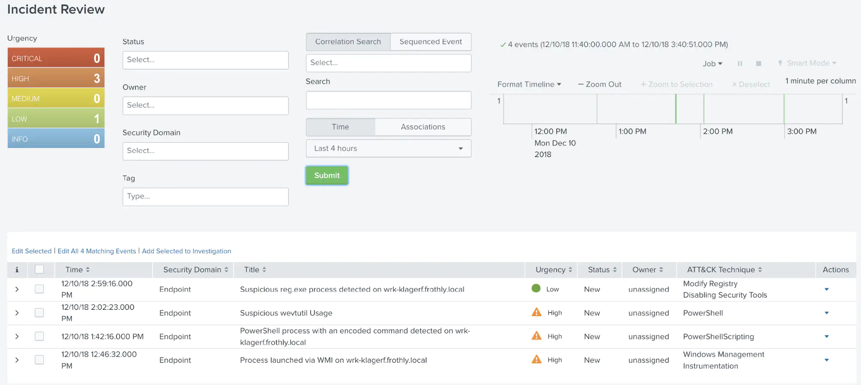
Splunk notables (Alerts) example

Slide 8
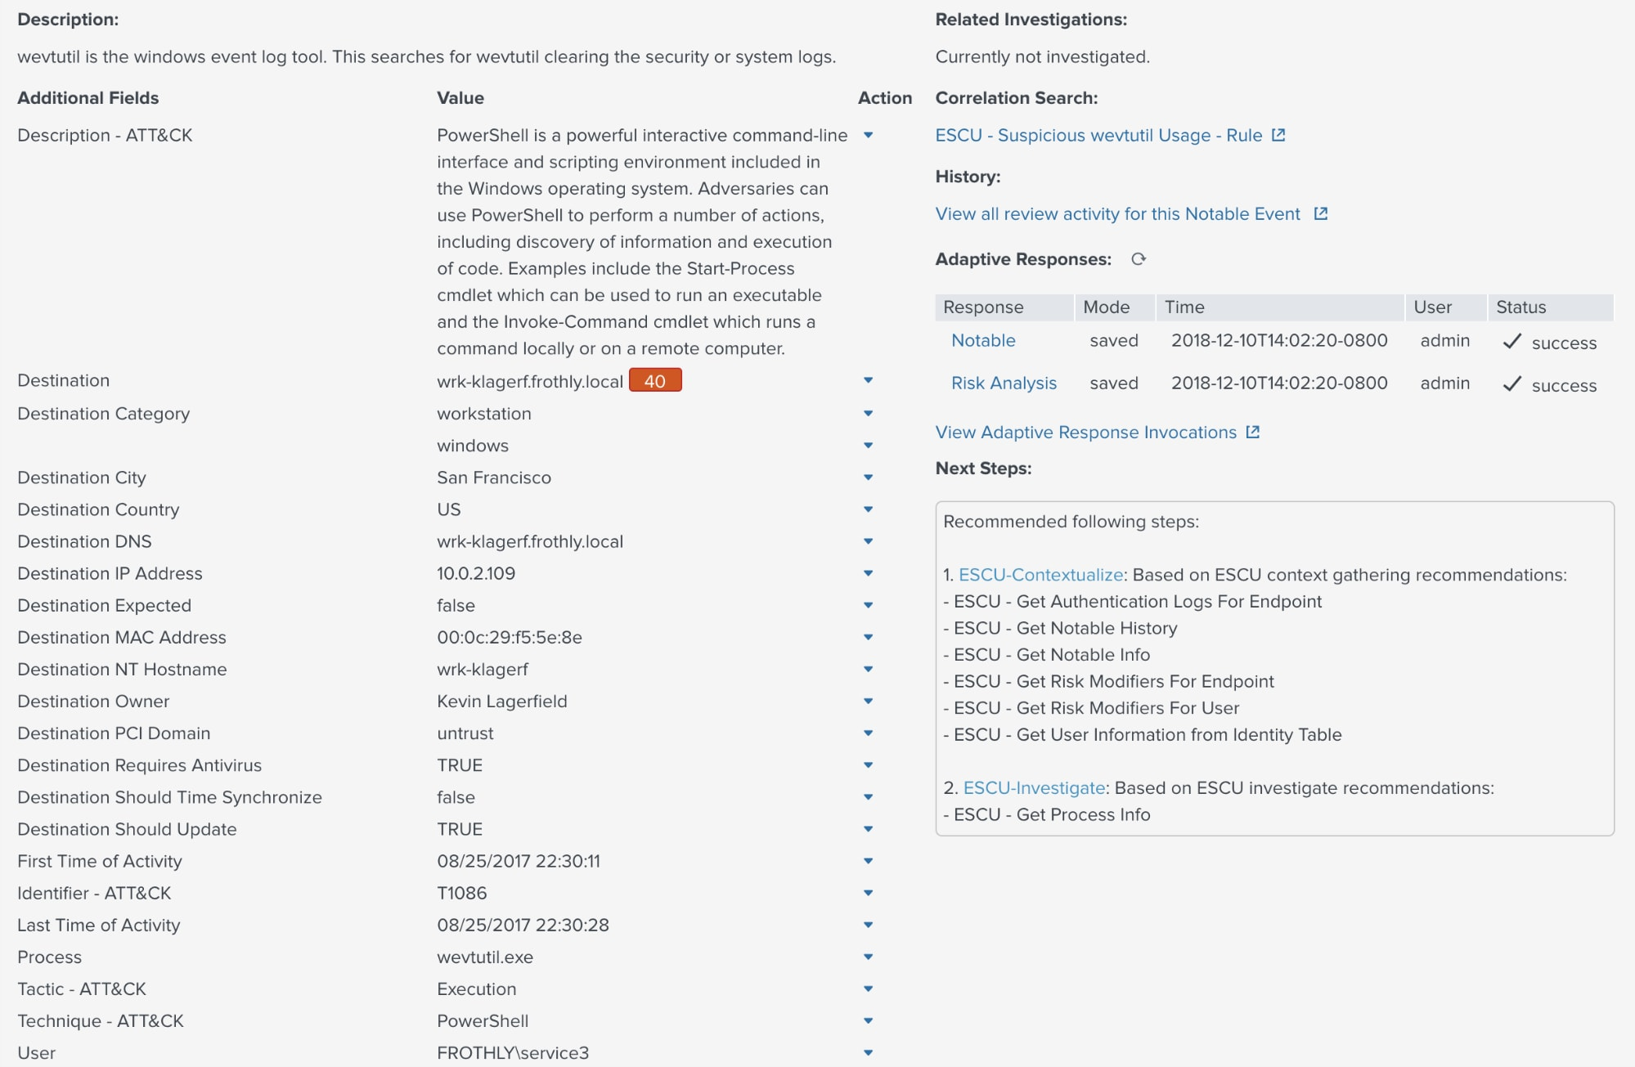
Splunk notables (Alerts) example

Slide 9
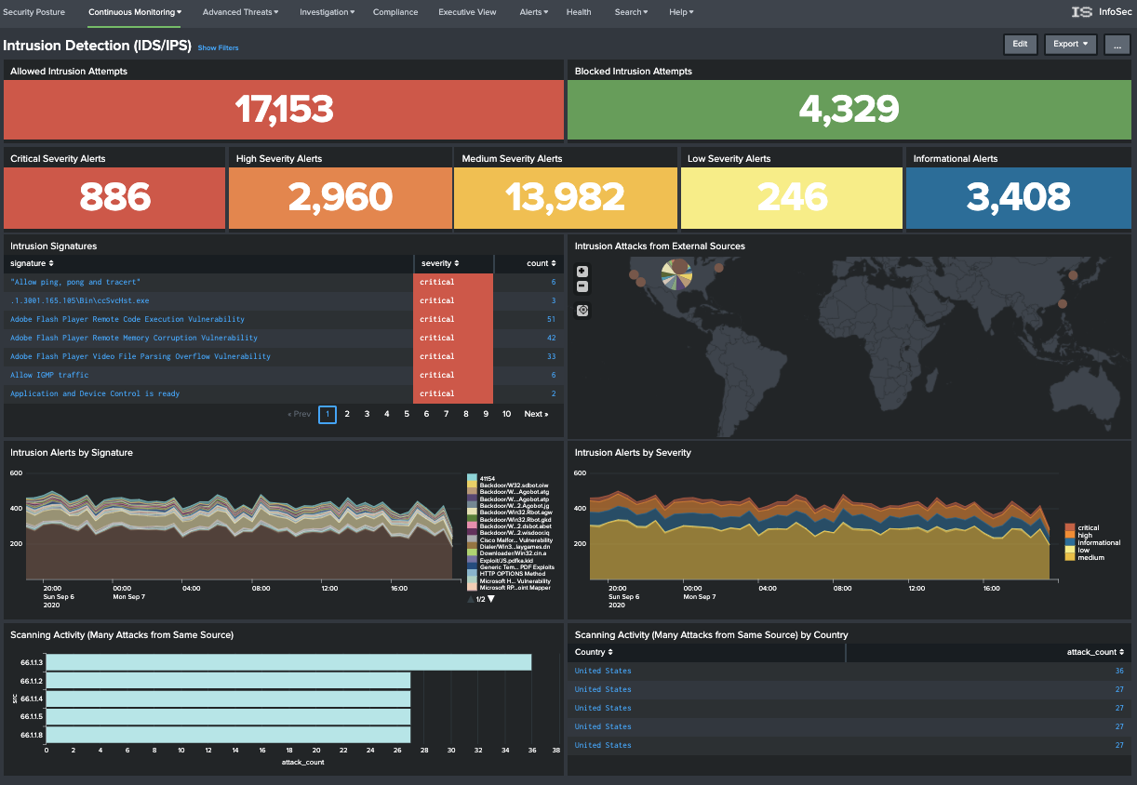
Splunk dashboard example

Slide 10
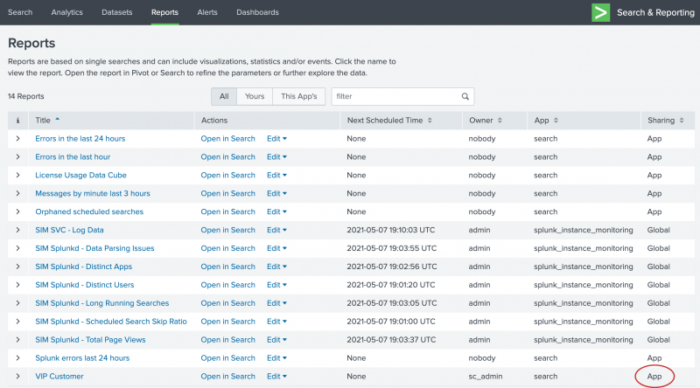
Splunk reports example

Slide 11
Triage
To triage means to assign a level of importance or urgency to incidents, which then determines the order in which they will be investigated
Done in the following way:
Review the alerts by actively investigating the trigger
Close an alert if it is qualified as false positive
Park the alert if same offense triggered multiple time to understand it is false positive or legit one
Categorize the alerts based on severity and impact

Slide 12
Basic Investigation
It is the process of investigating, analyzing and gathering relevant evidences about the security incident
Done in the following way:
Identify which Rule triggered an alert
Try to collect as much information as possible.
Identify which log sources & systems triggered the alert
Identify users or potential actors involved in the an incident
Search past alerts/incidents
Understand attack vectors
Use the available threat intelligence
Search related events, flows, vulnerabilities and active exploits

Slide 13
Deep dive investigation
Perform threat hunting based on the IOC’s and IOA’s
Identify the related activity during the given timeline
Try to correlate the actions and identify the source of infection or the root cause of the activity
Use advanced detection and remediation mechanisms like EDR

Slide 14
Remediation
Gather incident information as below and forward it to respective teams
List of affected hosts
Potentials Actors / users
attack vector information
If the incident is a false positive – create tuning request and send to SOC Admin Team

Slide 15
Incident detection and response – complete picture
EDR / AV
Detection
IDS,IPS and FIREWALL
SIEM
SOAR
SERVER
CLOUD
Log Sources
Detection and correlation
Orchestration and Response

Slide 16
What is an edr
Endpoint detection and response (EDR), also known as endpoint threat detection and response (ETDR), is an integrated endpoint security solution that combines real-time continuous monitoring and collection of endpoint data with rules-based automated response and analysis capabilities.
The primary functions of an EDR security system are to:
Monitor and collect activity data from endpoints that could indicate a threat
Analyze this data to identify threat patterns
Automatically respond to identified threats to remove or contain them, and notify security personnel
Forensics and analysis tools to research identified threats and search for suspicious activities
Credits: https://www.trellix.com/en-us/security-awareness/endpoint/what-is-endpoint-detection-and-response.html

Slide 17
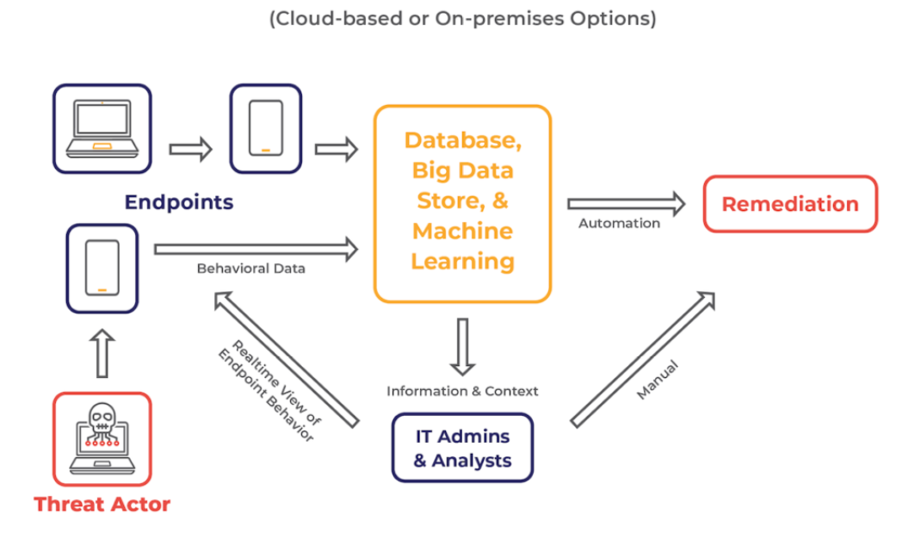
HOW EDR works

Slide 18
Key components of EDR security
EDR security provides an integrated hub for the collection, correlation, and analysis of endpoint data, as well as for coordinating alerts and responses to immediate threats. EDR tools have three basic components:
Endpoint data collection agents: Software agents conduct endpoint monitoring and collect data—such as processes, connections, volume of activity, and data transfers—into a central database
Automated response: Pre-configured rules in an EDR solution can recognize when incoming data indicates a known type of security breach and triggers an automatic response, such as to log off the end user or send an alert to a staff member
Automated response: Pre-configured rules in an EDR solution can recognize when incoming data indicates a known type of security breach and triggers an automatic response, such as to log off the end user or send an alert to a staff member
Credits: https://www.trellix.com/en-us/security-awareness/endpoint/what-is-endpoint-detection-and-response.html

Slide 19
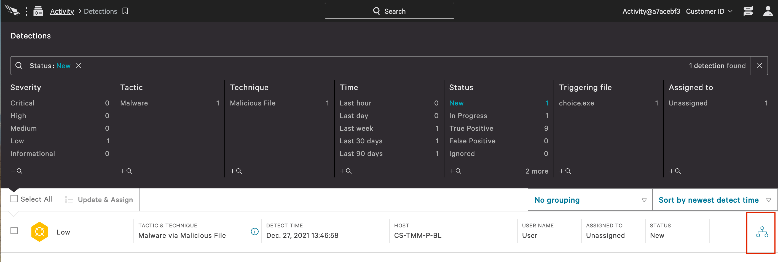
Sample EDR detection
Credits: https://www.crowdstrike.com/blog/tech-center/generate-your-first-detection/

Slide 20
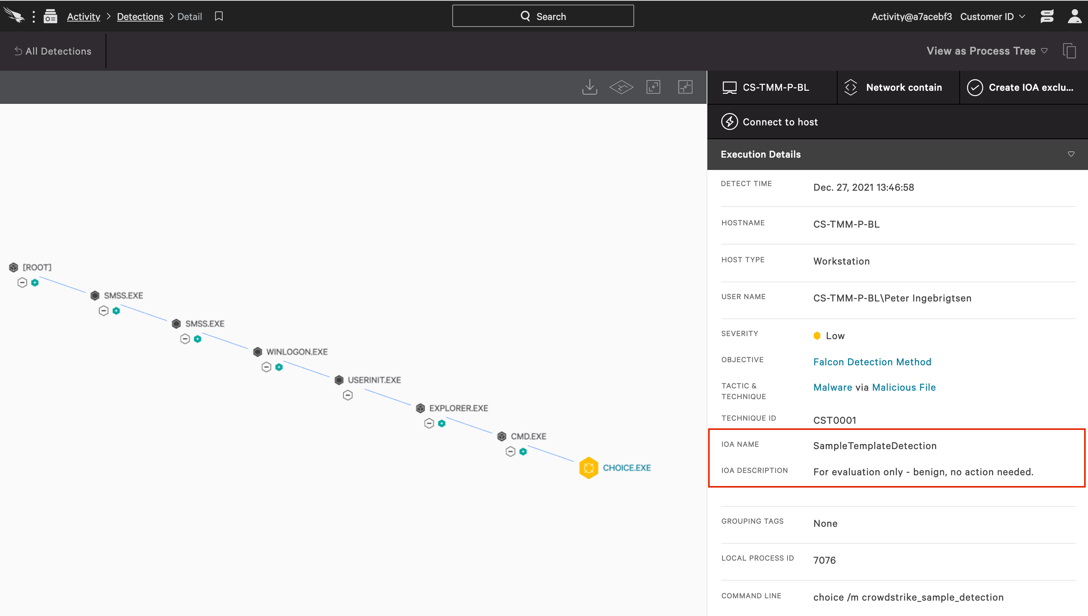
Sample EDR detection
Credits: https://www.crowdstrike.com/blog/tech-center/generate-your-first-detection/

Slide 21
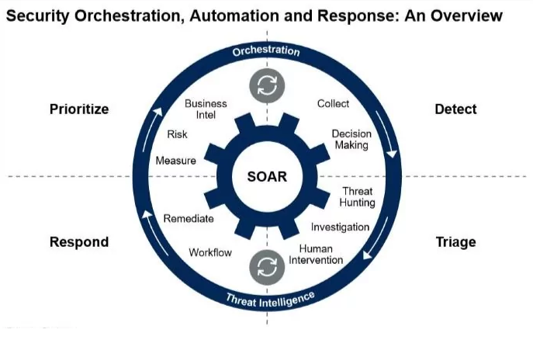
What is a soar
SOAR refers to technologies that enable organizations to collect inputs monitored by the security operations team
Credits: https://www.ibm.com/security/digital-assets/soar/how-to-be-a-soar-winner/

Slide 22
The ABC’s of SOAR
Automation
The ability to perform functions without human intervention. These functions may be internal
Orchestration
The creation of a sequence of multiple steps and/or actions that drive a particular process or response
Orchestration typically involves human action as well as automated steps
Case/Incident
This refers to the end-to-end process of investigation, containment and remediation
A case/incident may include multiple workflows, depending on how an attack evolves
Credits: https://www.ibm.com/security/digital-assets/soar/how-to-be-a-soar-winner/

Slide 23
The ABC’s of SOAR
Playbook
A set of tasks that may or may not include external automation, which is associated with a specific threat type such as phishing or network intrusion
A playbook determines the organizational response to a particular threat and should include business processes as well as technical tasks
Playbooks are additive, such that a complex incident may consist of multiple playbooks
Workflow
A workflow describes a specific set of actions around a particular security process. A playbook is made up of multiple workflows
App/Integration
An Application (App) or Integration is a packaged set of functions, rules, scripts and workflows that links the y SOAR API to third-party security
It can also be IT ops tools in order to leverage that external tools capabilities as part of the incident response process
Credits: https://www.ibm.com/security/digital-assets/soar/how-to-be-a-soar-winner/

Slide 24
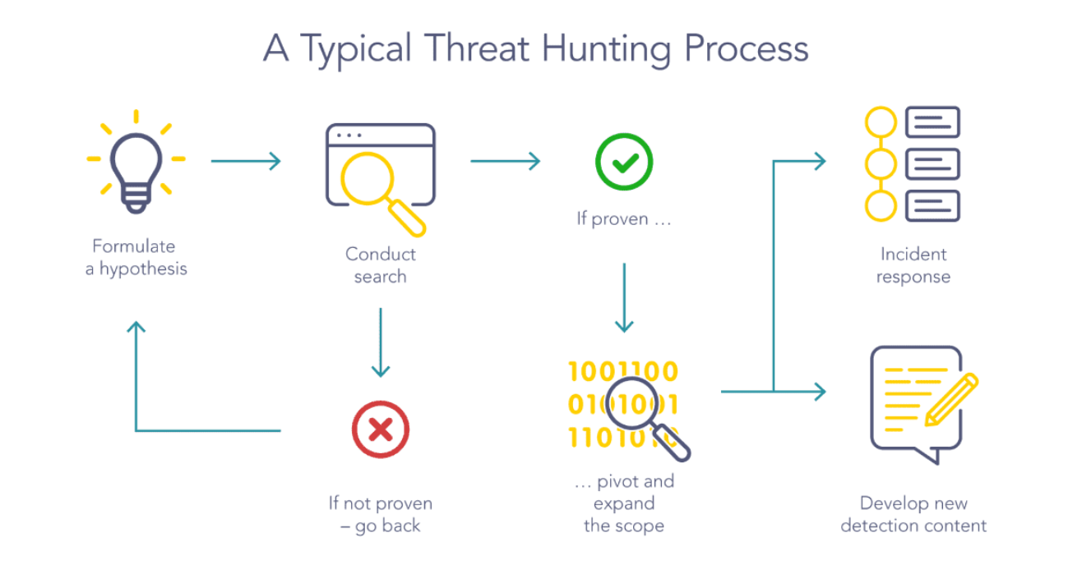
Cyber threat hunting

Slide 25
Threat Hunting Methodologies
In proactive threat hunting, the initiation of investigation typically falls into three main categories:
Hypothesis-driven investigation
Hypothesis-driven investigations are often triggered by a new threat that’s been identified through a large pool of crowdsourced attack data, giving insights into attackers’ latest tactics, techniques, and procedures (TTP)
Once a new TTP has been identified, threat hunters will then look to discover if the attacker’s specific behaviors are found in their own environment
Investigation based on known IOC and IOA
This approach to threat hunting involves leveraging tactical threat intelligence to catalog known IOCs and IOAs associated with new threats
These then become triggers that threat hunters use to uncover potential hidden attacks or ongoing malicious activity
Advanced analytics and machine learning investigations
The third approach combines powerful data analysis and machine learning to sift through a massive amount of information in order to detect irregularities that may suggest potential malicious activity
These anomalies become hunting leads that are investigated by skilled analysts to identify stealthy threats
Credits: https://www.crowdstrike.com/cybersecurity-101/threat-hunting/

Slide 26
Thank you Have a happy weekend

